Slide 1

Voice Sentiment Analysis Tool
Submitted by -
Mannava Siri chandana -19mis7114
Mallela Jahnavi - 19mis7094
Galla Harika – 19mis7077
“Summer project ”

Slide 2
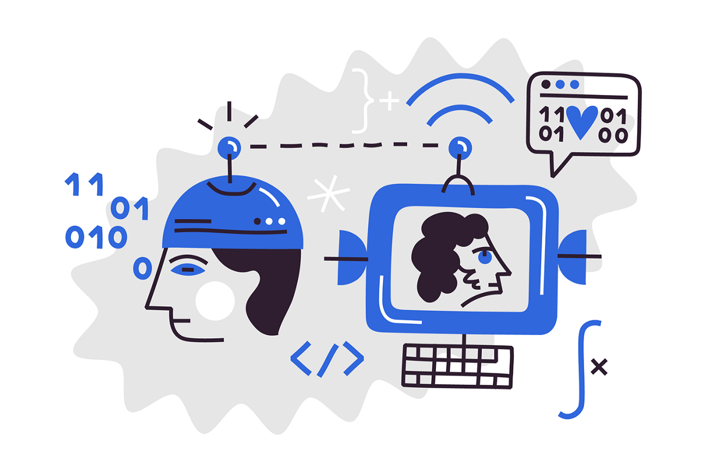
Voice Sentiment Analysis
- AI Powered Sentiment Analysis tool for Aged People

Slide 3
About the Project
Voice sentiment analysis tool is a kind of detecting tool which is made for aged people to detect the emotions from their voice.
In backend tool detects sentiments from the voice and send alert to the guardians. So that guardian can take care of them.
Our system will detect the emotions first and then filter that out and if the emotion is “panic” then the SMS will be sent to the guardian as an alert.

Slide 4

Objective & Purpose of this Project
To help aged peoples.
To solve real world problem.
To get better understanding of aged people thoughts.
To help physically disabled people.

Slide 5
Requirements For Our Tool
Hardware Specification
GPU
4 GB RAM
Software Requirements:
Google Colab
Browser for Testing
PyCharm

Slide 6
Features of the Tool
SMS Alert Feature
Voice Selection Feature
Responsive Design
Instant Voice Sentiment Result

Slide 7
WATER FALL MODEL
Waterfall approach was first SDLC Model to be used widely in Software Engineering to ensure success of the project. In "The Waterfall" approach, the whole process of software development is divided into separate phases. In this Waterfall model, typically, the outcome of one phase acts as the input for the next phase sequentially.
The following illustration is a representation of the different phases of the Waterfall Model.

Slide 8
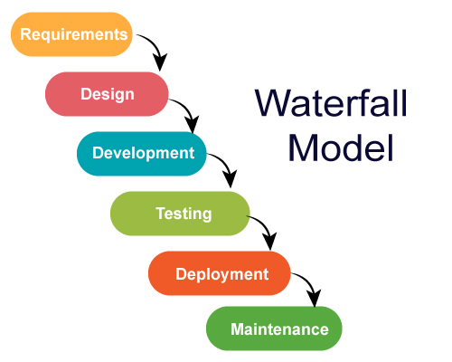
The sequential phases in Waterfall model are −
Requirement Gathering and analysis −
All possible requirements of the system to be
developed are captured in this phase and documented
in a requirement specification document.

Slide 9
System Design − The requirement specifications from first phase are studied in this phase and the system design is prepared. This system design helps in specifying hardware and system requirements and helps in defining the overall system architecture.
We created our project design demo with the help of Adobe XD and implemented that design using XML in android studio.

Slide 10
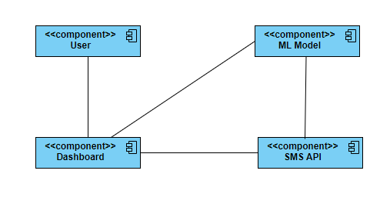
Component Diagram

Slide 11
DFD – Data Flow Diagram
A data flow diagram is a graphical representation that depicts information flow and the transforms that are applied as data move from input to output. The basic form of a data flow diagram, also known as a data flow graph or a bubble chart.
The data flow diagram may be used to represent a system or software at any level of abstraction. As information moves through software, it is modified by a series of transformations.

Slide 12
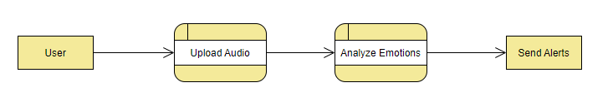
Level 0 DFD

Slide 13
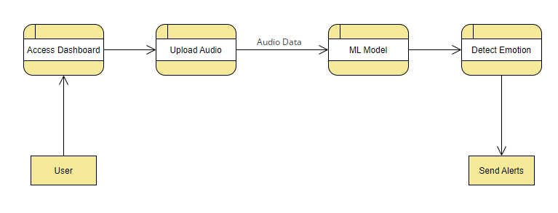
Level 1 DFD

Slide 14
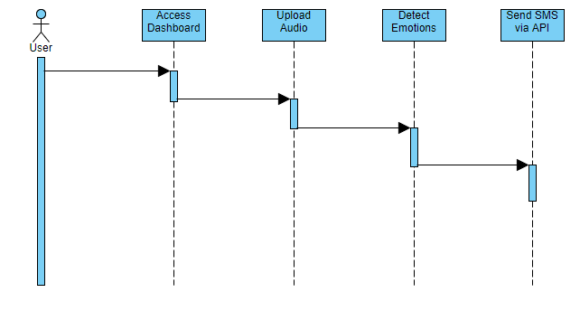
Sequence Diagram

Slide 15
About Dataset
Ryerson Audio-Visual Database of Emotional Speech and Song (RAVDESS) dataset is used in this system for the voice sentiment analysis.
RAVDESS contains 1440 files: 60 trials per actor x 24 actors = 1440. The RAVDESS contains 24 professional actors (12 female, 12 male), vocalizing two lexically-matched statements in a neutral North American accent. Speech emotions includes calm, happy, sad, angry, fearful, surprise, and disgust expressions.
File naming convention - Each of the 1440 files has a unique filename. The filename consists of a 7-part numerical identifier (e.g., 03-01-06-01-02-01-12.wav).

Slide 16

About Sinch Sms API
To send SMS on user phone after detection emotion we used Sinch Sms API support.
This is the fast and best API for send SMS with the help of Python code.
This API Send and receive SMS through a single connection for timely and cost-efficient communications using the Sinch SMS API.

Slide 17
Python Code to Send SMS
from_ = "447520651530"
to_ = “9199999999"
headers = {
"Authorization":f"Bearer {b0ca53e01801441da0d4a54def053b48}",
"Content-Type":"application/json"
}
payload = {
"from":from_,
"to":[to_],
"body":message
}
response = r.post(
f'https://sms.api.sinch.com/xms/v1/{ec9eae3c15704184b8aff9b7ba21c742}/batches',
headers=headers,
data=json.dumps(payload)
).json()

Slide 18


TECHNOLOGIES TO BE INCORPORATED AND WORKED UPON:
Machine Learning
Django
Machine learning in healthcare to supplement patient care for better results. Machine learning has made easier to identify different diseases and diagnosis correctly.
Django is a high-level Python web framework that enables rapid development of secure and maintainable websites. Django is a free and open-source web framework.

Slide 19




Tools and Frameworks Used
Machine Learning
Frontend Web Interface
Backend Web Interface
Data Storage
Python
Scikit Learn
Django
Python
JavaScript
Python Pickle
HTML
CSS
Bootstrap
jQuery

Slide 20







WORKFLOW OF OUR TOOL
Dataset
Feature Extration
Model Selection
Train Model
Test Data Input
Prediction
Send Message
Stop

Slide 21
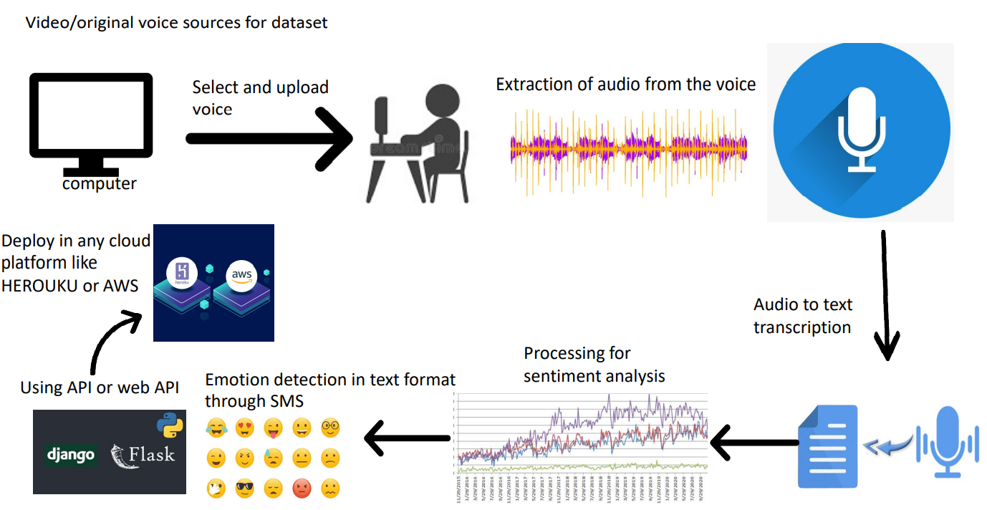
Over view of our project

Slide 22
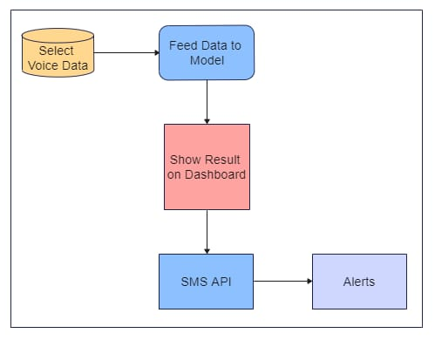
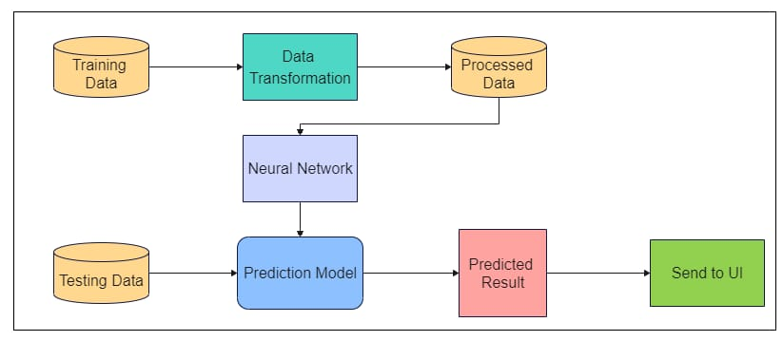
Architecture diagram

Slide 23
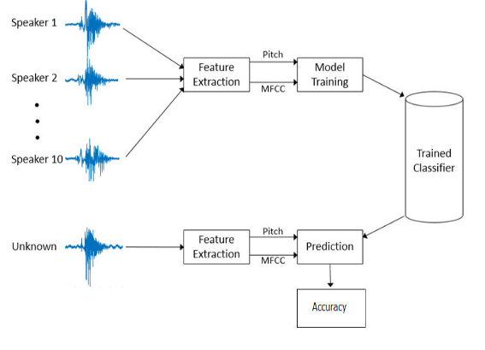
FEATURE EXTRACTION PROCESS

Slide 24
MLP CLASSIFIER
ADVANTAGES OF USING MLP
1. Provides the flexibility to work with nonlinear values 2. Less number of parameters required 3. Higher performance compared to previous systems 4. Better classification of parameters is shown. 5. Can handle missing values, model complex relationships and support multiple input

Slide 25
DISADVANTAGES OF USING MLP
MLPs always need fixed number of inputs to be provided for fixed number of outputs, there is a fixed mapping function between the inputs and the outputs in these feed-forward neural networks that pose a problem when a sequence of inputs is provided to the model.
2. Network must be retrained when a new emotion is added to the system

Slide 26
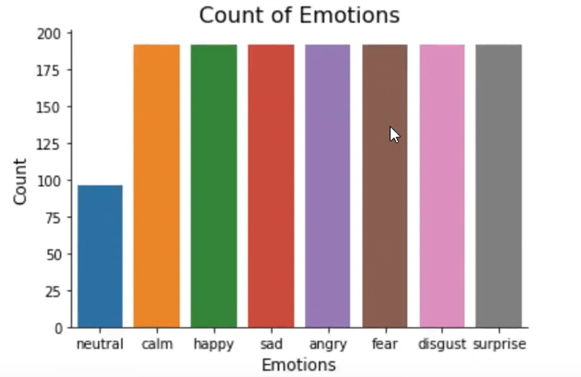
OBSERVATION

Slide 27
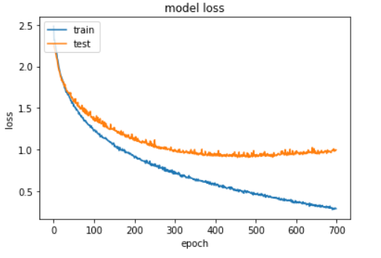
Training and testing

Slide 28
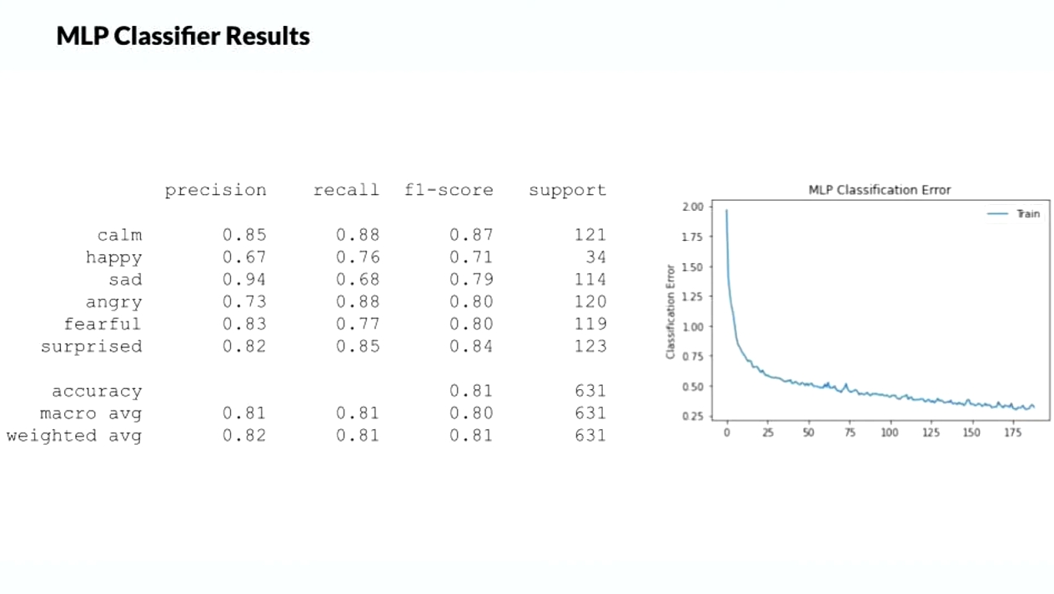
MLP CLASSIFIER

Slide 29
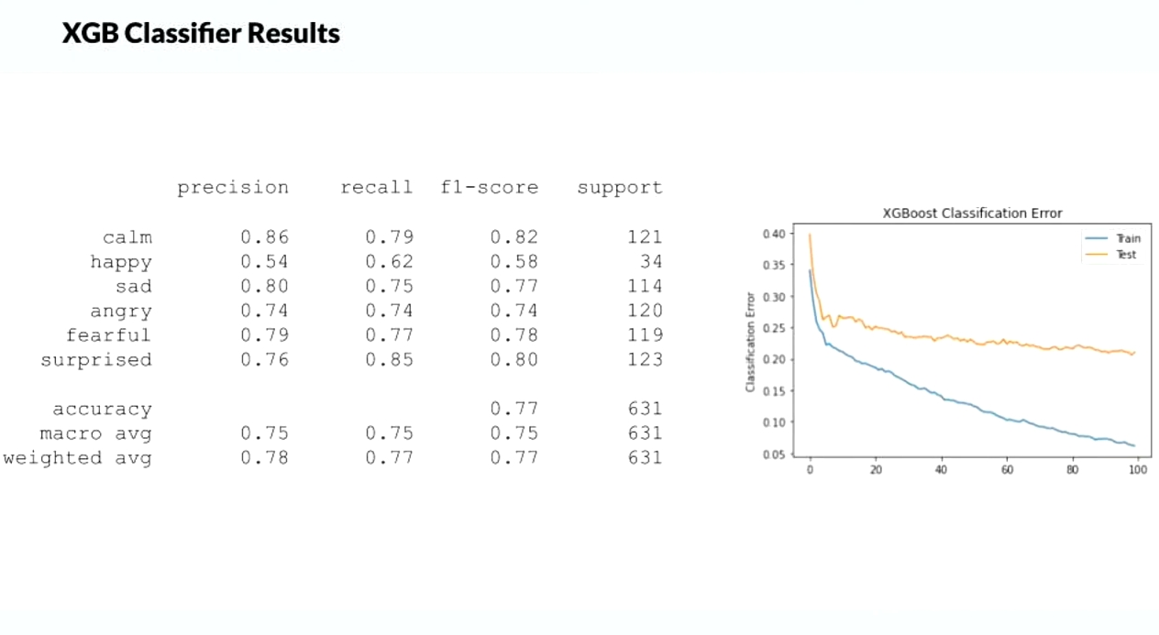
XGB BOOSTER

Slide 30
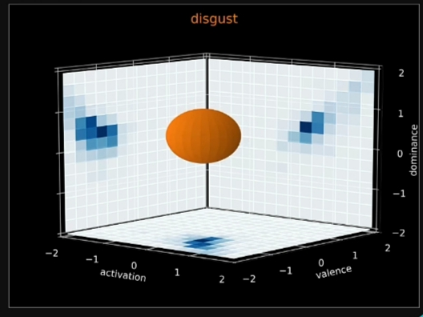
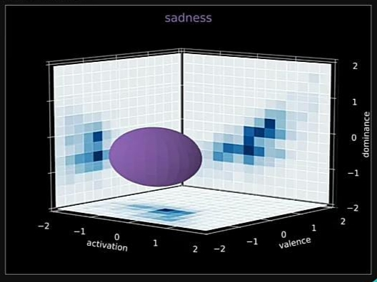
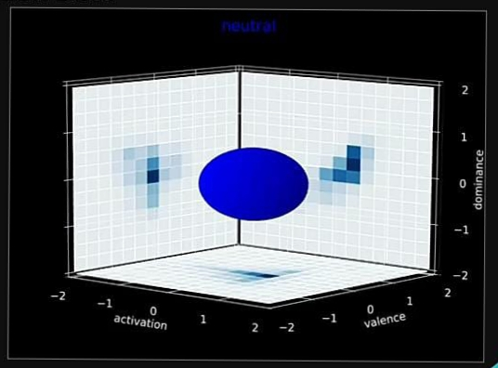
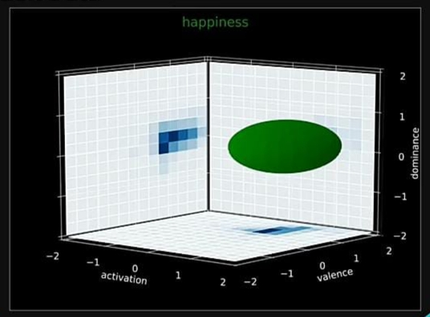
EMOTION DETECTION

Slide 31
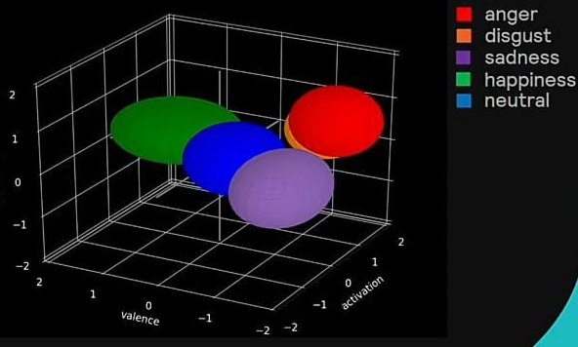
Over all emotion detection

Slide 32
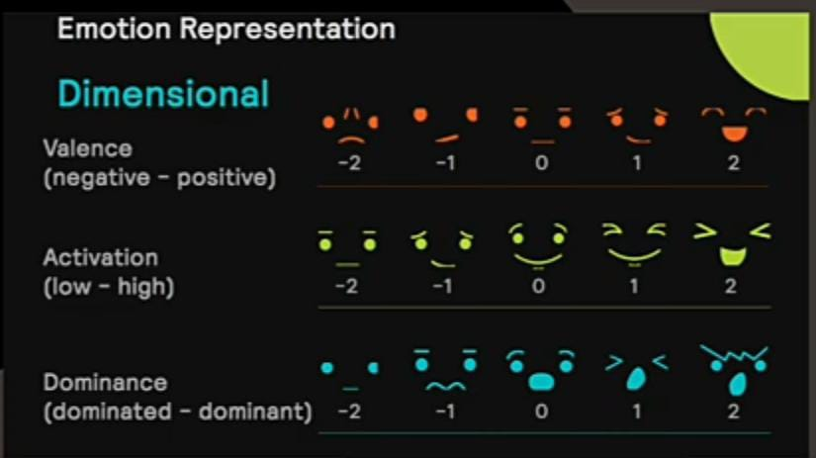
Emotion detection

Slide 33
Future Scope of the Project
In Future we will add some more features to our voice sentiment analysis tool like -
WhatsApp Alerts
Continuous Sound Listening Feature
Guardian Dashboard to check History
Online Audio/Video Input Feature

Slide 34
THANK YOU!!

